Slide 1
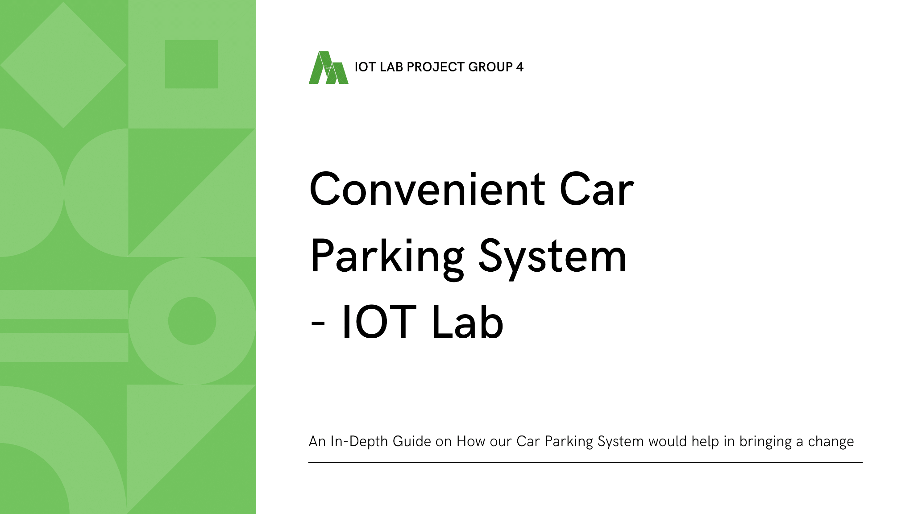

Slide 2
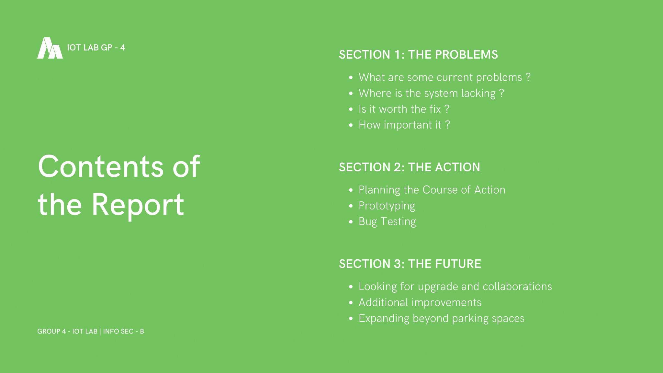
IoT Lab

Slide 3
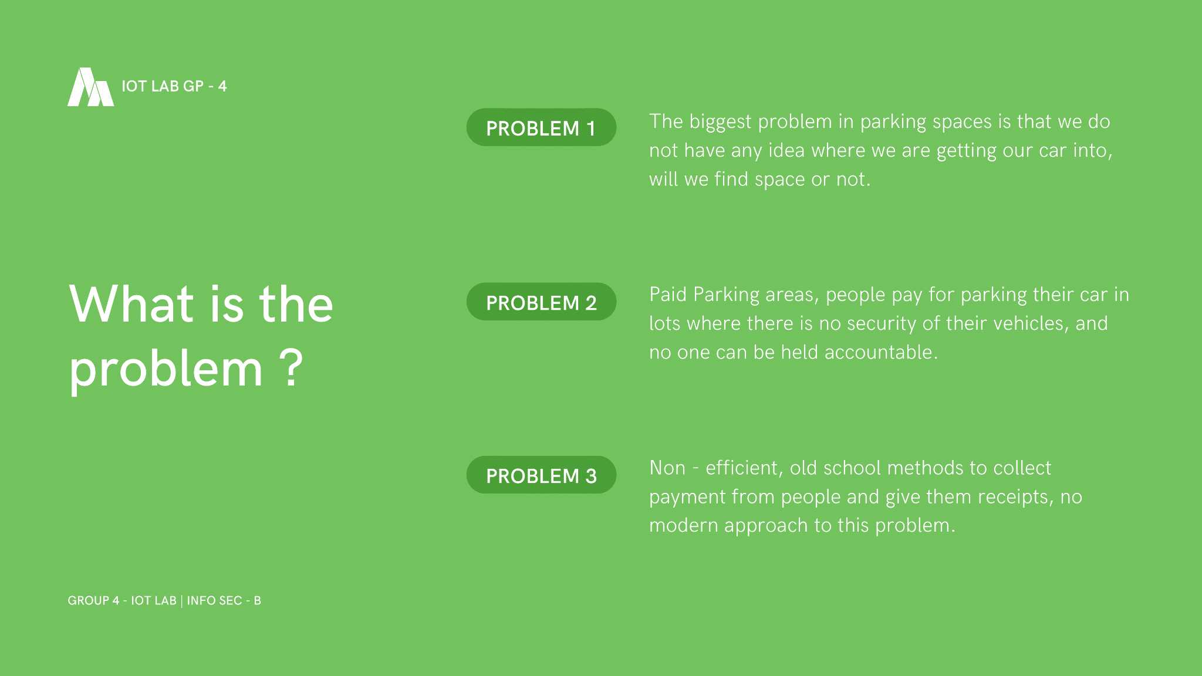
IoT Lab

Slide 4
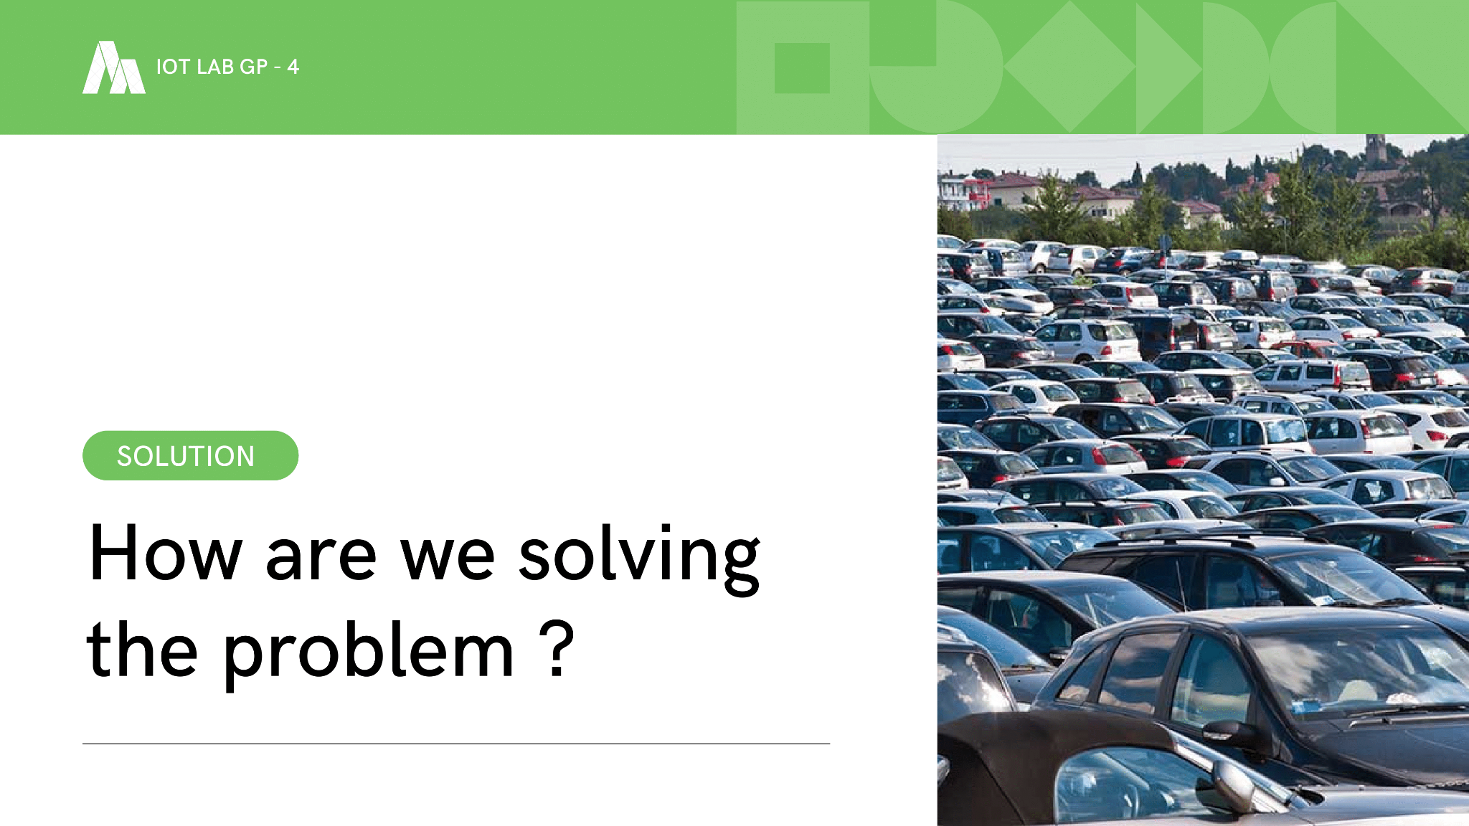
IoT Lab

Slide 5

IoT Lab

Slide 6
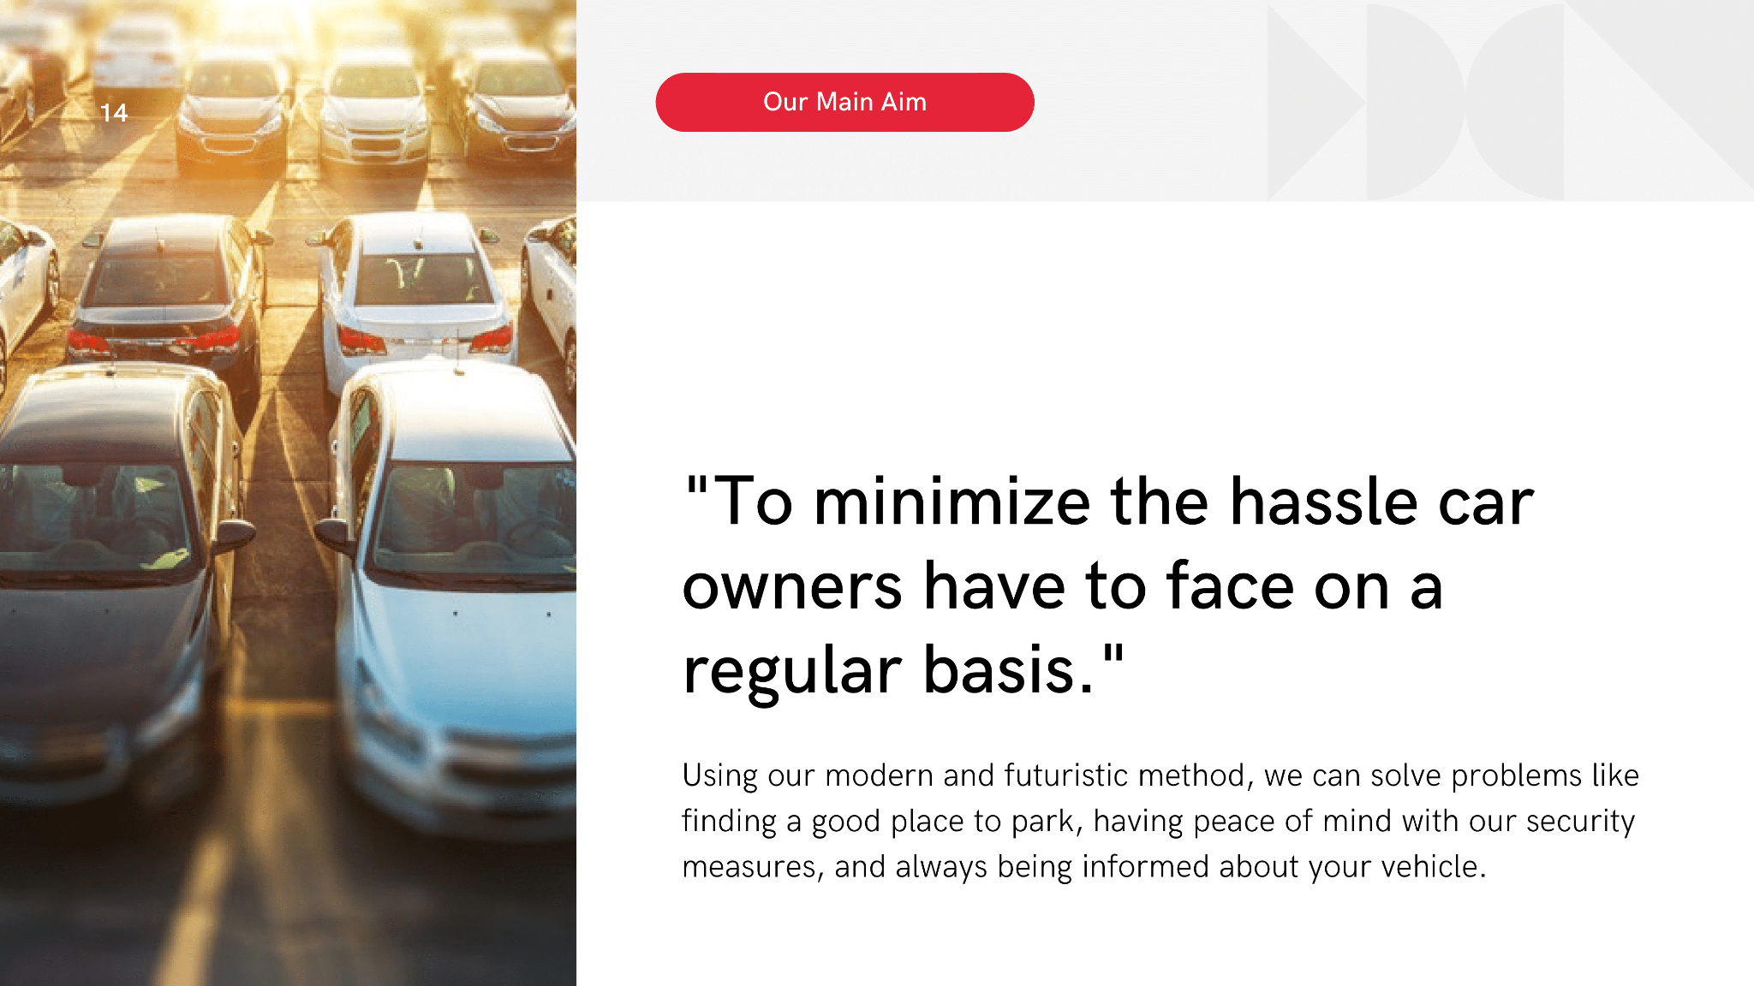

Slide 7

IoT Lab

Slide 8

IoT Lab

Slide 9
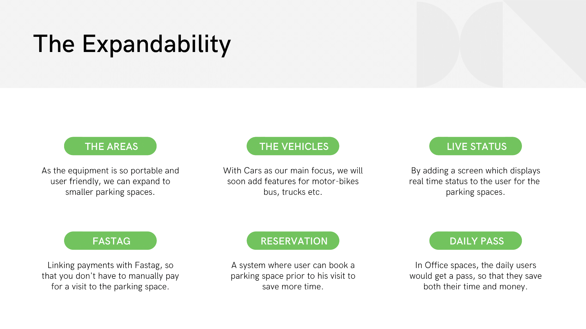

Slide 10
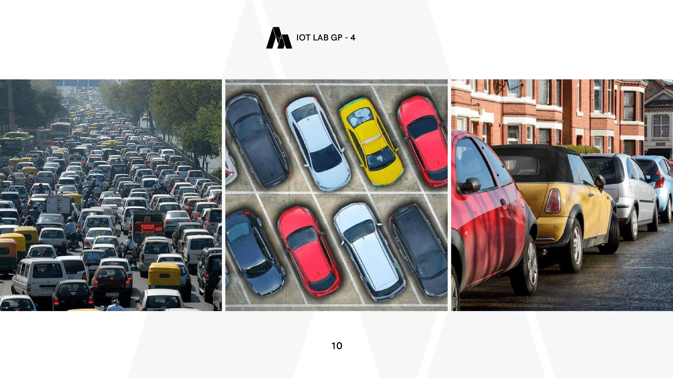

Slide 11

IoT Lab

Slide 12
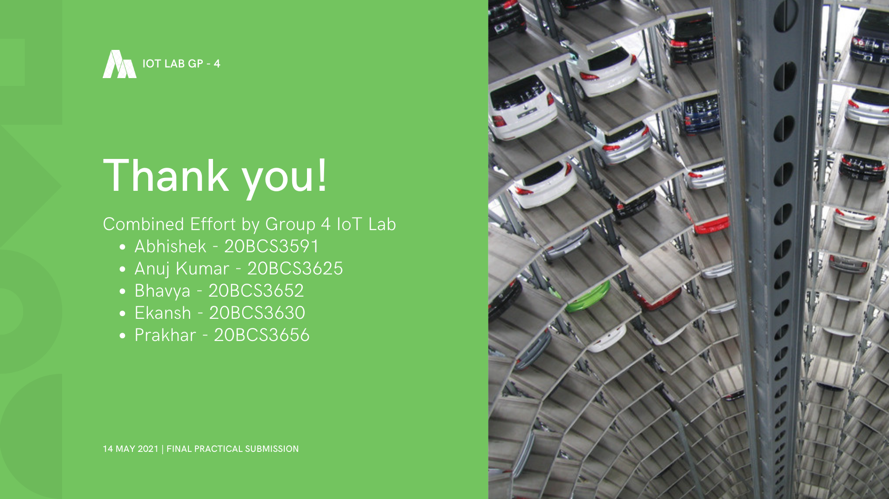
IoT Lab
A combined effort by:
BHAVYA SEHGAL
EKANSH SHARMA
PRAKHAR NIGAM
ANUJ KUMAR SINGH

